Slide 1


Technology Advancement in Gaming
Darrus Lee

Slide 2


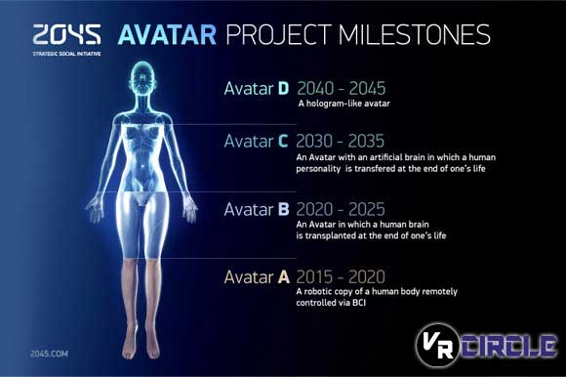
Full Dive (FD) System
Utilizes all sense
Sense of motion if crucial
Neuromapping is one of the deal breakers
Proprioception
Sense of movement
Bad news: Current technology cannot achieve this

Slide 3
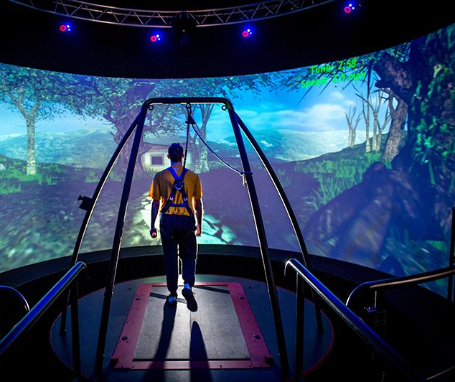
Virtual Reality (VR)
Virtual reality is the closest thing to FD
Virtual reality is a three-dimensional computer generated environment which can be explored and interacted by the person
Virtual reality nowadays achieved through a headset, omni-directional treadmill, and special gloves
Virtual reality has other benefits too:
Architecture, sport, medicine, arts, and entertainment
VR becoming more widespread

Slide 4

Video game mobility

Slide 5
Full Body gaming Suit

Slide 6
Virtual reality headsets

Slide 7
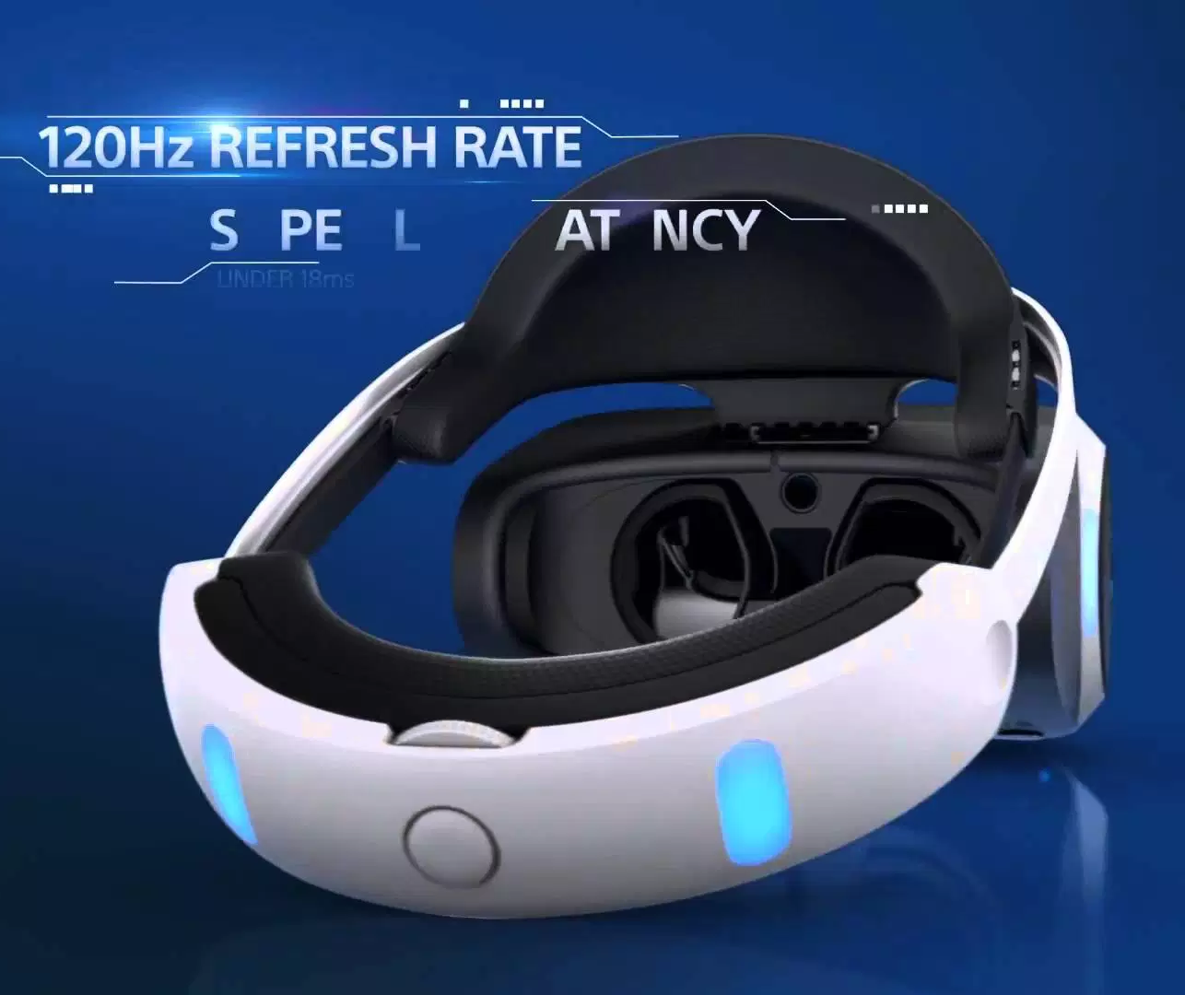
Playstation VR Effect
Sony became the first console manufacturer to embrace VR
Playstation VR is successful
Sony wants to return to the market with a higher-tech iteration for PS 5
SemiAccurate claim that PS5 will have a VR capability built-in at silicon level
A 4K resolution per eye
8K resolution in total
PS5 may become the first native 4K console that runs wireless

Slide 8
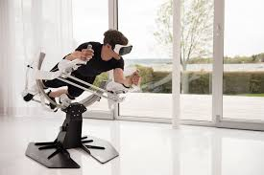

ICAROS & Happy Finish
ICAROS
Happy Finish
Vr fitness
Improve balance & coordination, and reflexes
Proven to burn 30% more calories and to double the muscle activity compared to stable kneeling planks
Play games and workout at the same time
The slide
High resolution with a 360 degree
Custom built motion platform
20-60 degree tilts

Slide 9

A real picture or digitally animated?

Slide 10
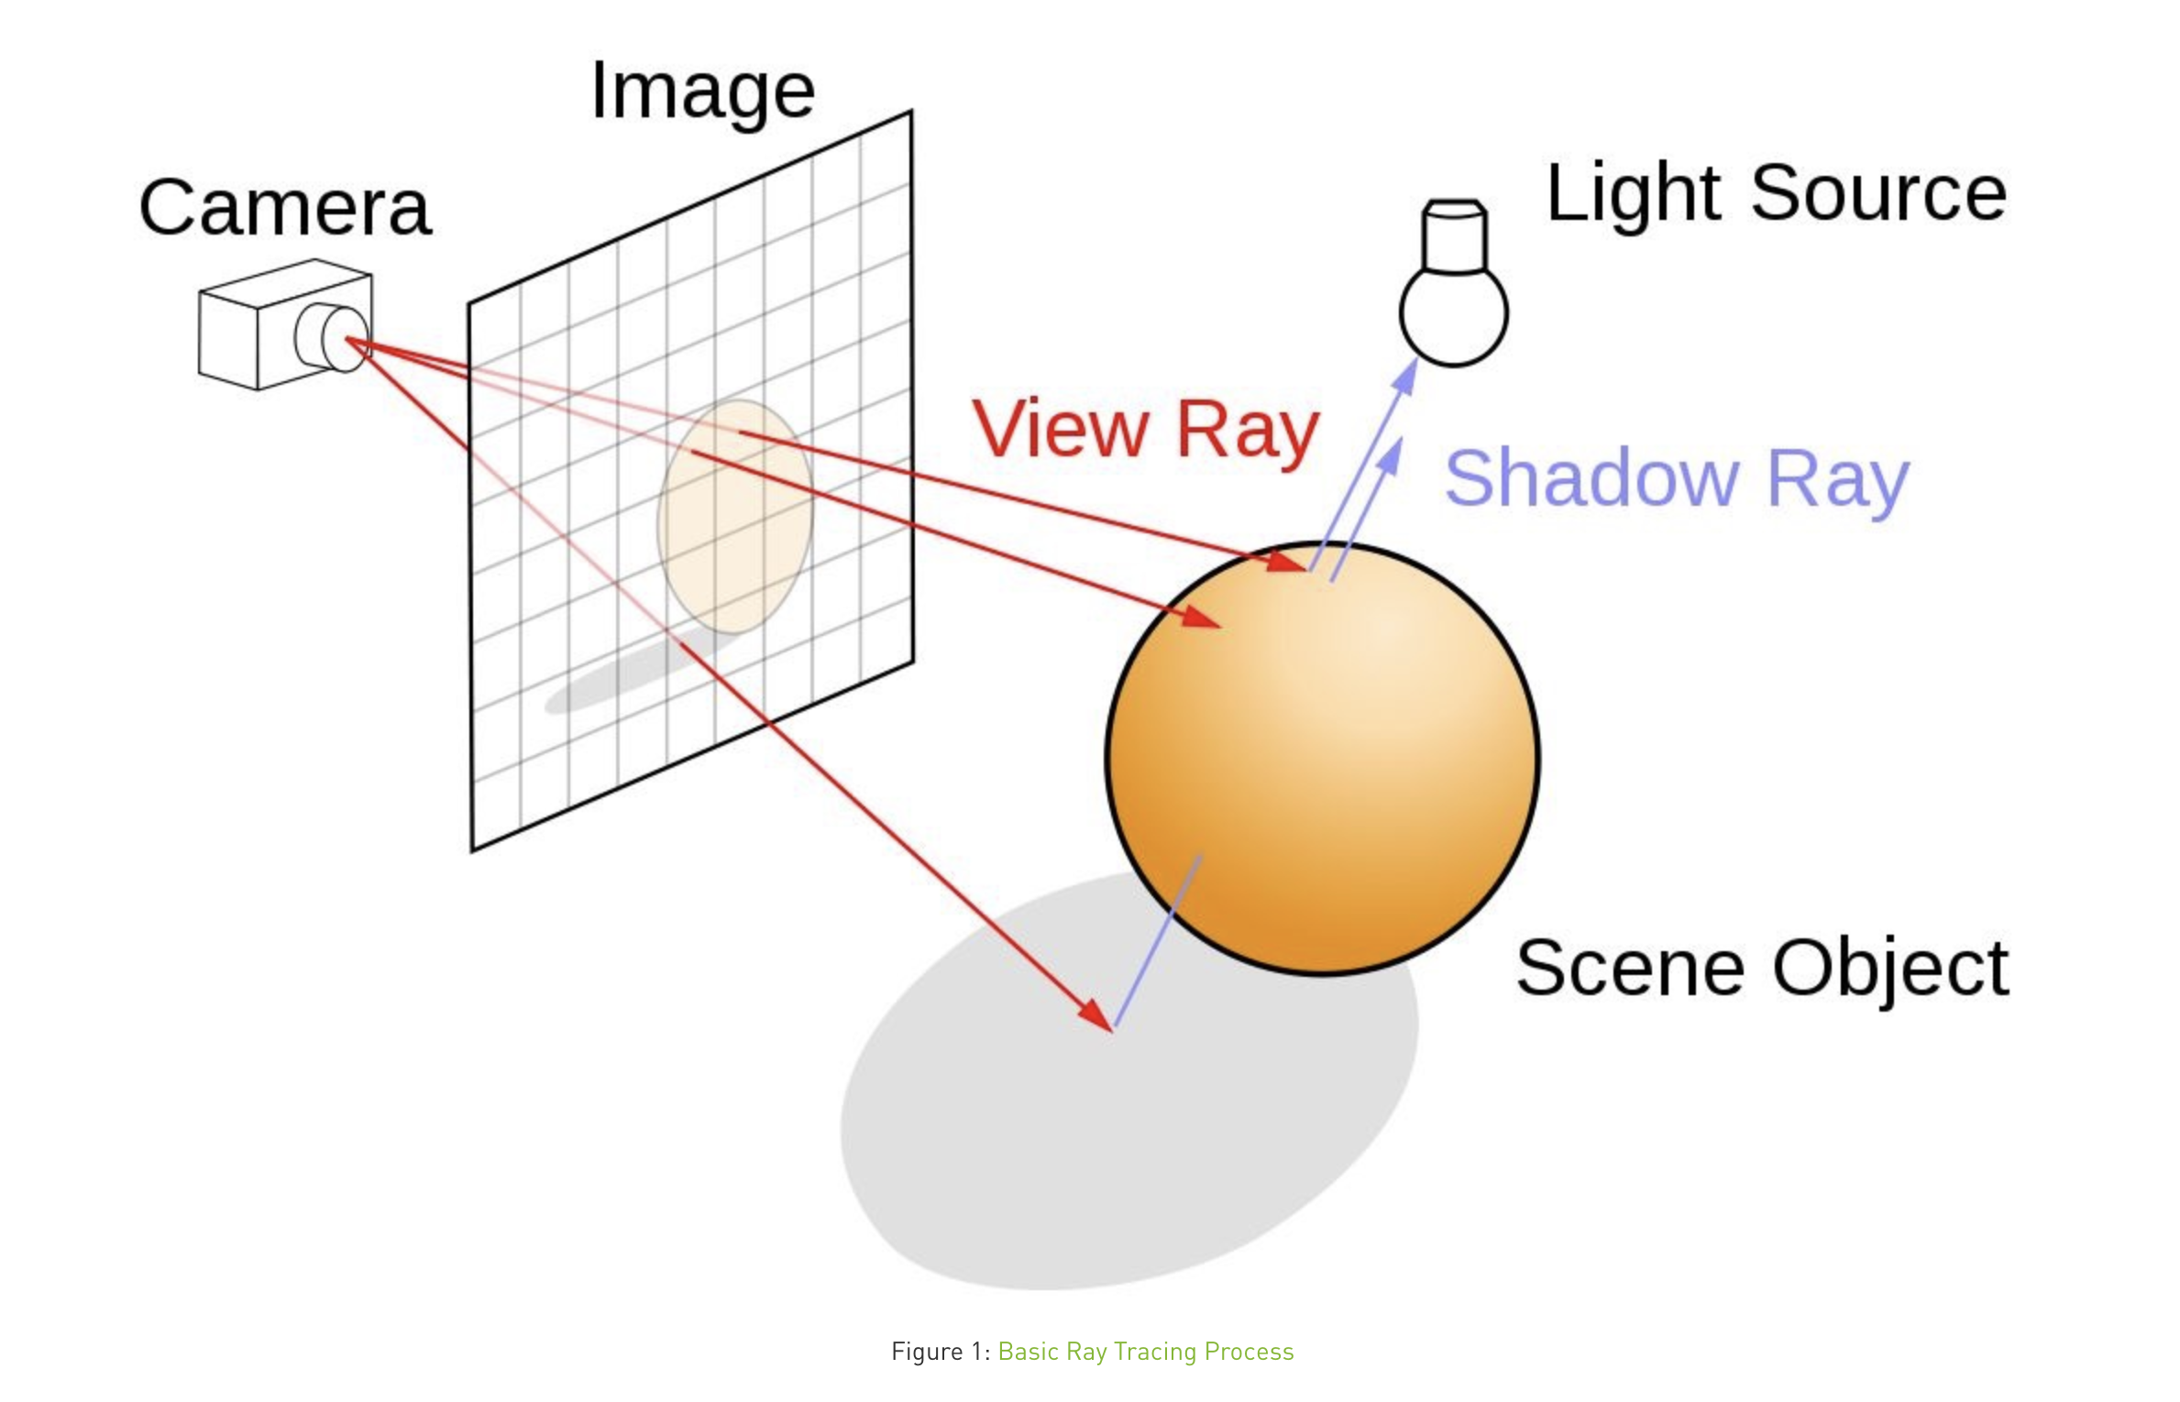
What is ray-tracing?

Slide 11
Ray Tracing Example
Notes:
0:25 - 2 min mark.

Slide 12
Real-Time Ray Tracing
Notes:
2:34 - 4:03 min

Slide 13
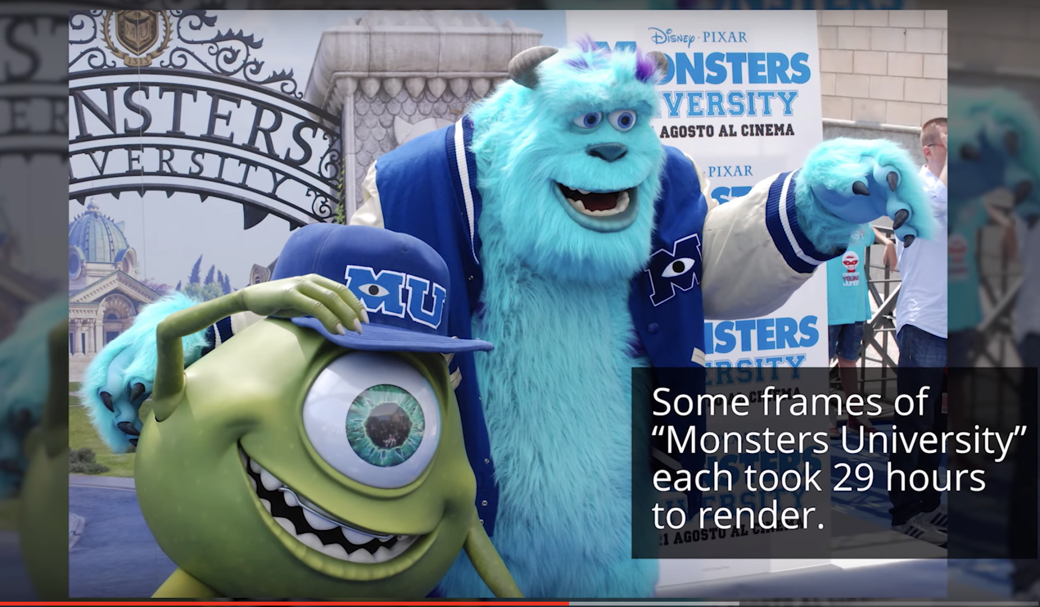
Ray Tracing in Movies

Slide 14

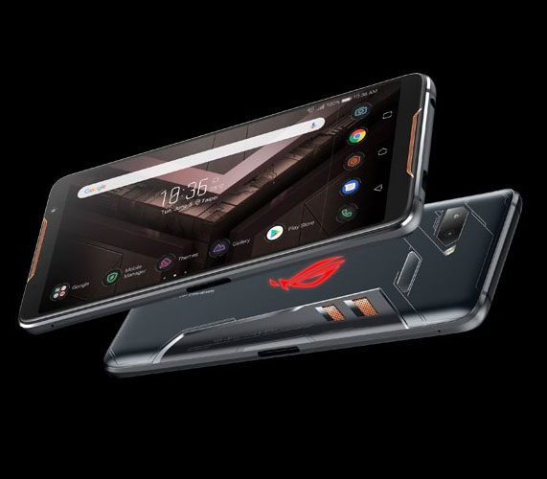
Smartphones made for gaming

Slide 15
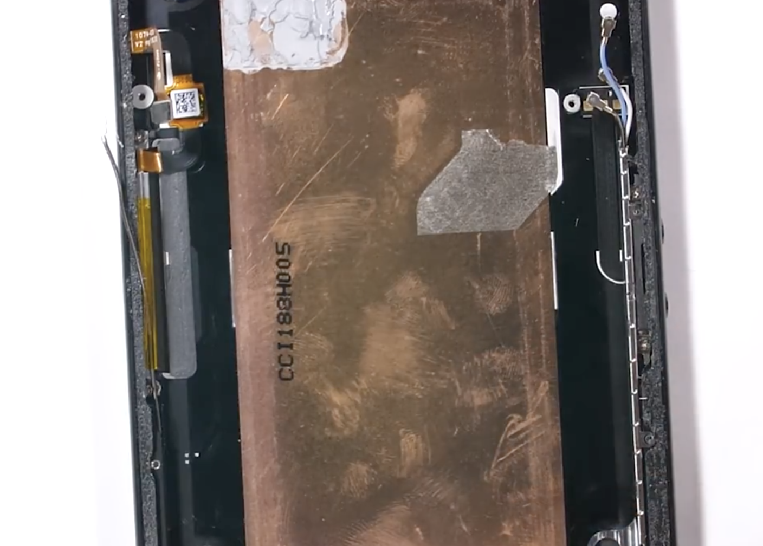
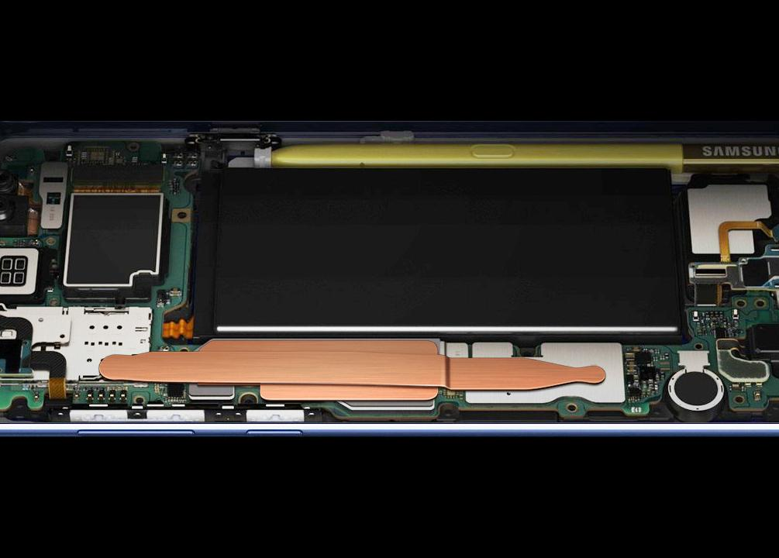
Features of
Gaming Smartphones
Cooling System
No Overheating
Powerful Processors
Speaker Placement
Battery Life

Slide 16
Facial Recognition
Notes:
Stop at 2 min mark

Slide 17
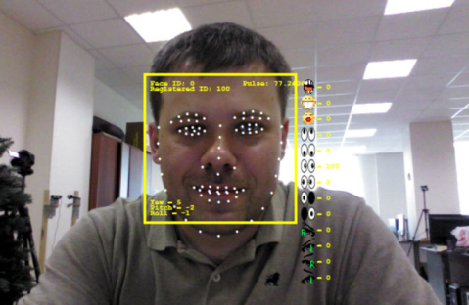
Facial Recognition
Create custom character or avatar
Facial expressions will be digitally created
RealSense 3D camera scans 78 different points on an individual’s face
Measures face features and distinguishes human emotions
Gaming experience will be more interactive and vivid

Slide 18

Facial Recognition
Video game Honor of Kings is currently testing the use of facial recognition to detect underaged users
Over 200 million registered players
Linked to game addiction, resulted in a 13 year old boy jumping off a building and a girl who spent over $14,700 for game items
Facial recognition will limit individuals on how long they can play the game

Slide 19
Cloud Gaming

Slide 20
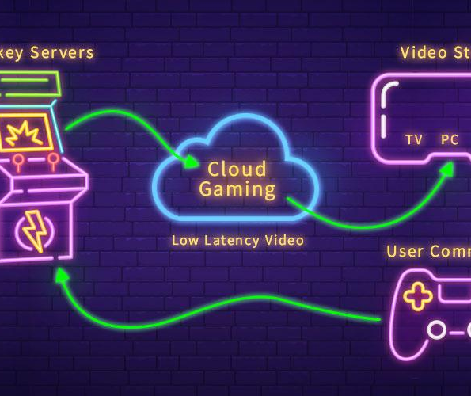
What is Cloud Gaming?
Related to video streaming services
Game resides on a company’s service, rather than on the gamer’s computer
The server runs the game itself while the user’s console sends all the inputs
Game server sends all video and audio output to the decide and the input is sent back to the server
Cloud gaming is the future of video games
users do not have to download a single byte and can play on virtually any PC

Slide 21

Cloud Gaming
Streaming live gameplay has become a big trend on Twitch and Youtube
Negative side of cloud gaming:
Video compression will lead to lower graphics
Cloud gaming can consume massive a amounts of bandwidth
Will not work if internet connection is limited

Slide 22
Microsoft & Cloud Gaming

Slide 23

Cloud Gaming
Google is a big supporter of the gaming industry
Popularity of smartphones have resulted in a new group of gamers
Google is planning the next significant game streaming service
Codename: Google Yeti
EA is another big player in the industry
recently acquired Gamefly
Allows user to stream games through cloud gaming that can be run through smart TV’s and Amazon Fire TV device

Slide 24
Gesture/Motion Gaming
A form of video games where the user’s body motions and movements act as the controls for the video game
Allows for a unique user experience and is different from the traditional controller/button games
Gesture/motion games detect movement in real time and allow the user to virtually interact with the game

Slide 25

Nintendo Wii
PS2/PSP and Xbox360 were popular and outperforming Nintendo DS and Gamecube.
Nintendo created the Wii Console
allowed for a unique user experience with the gaming device

Slide 26
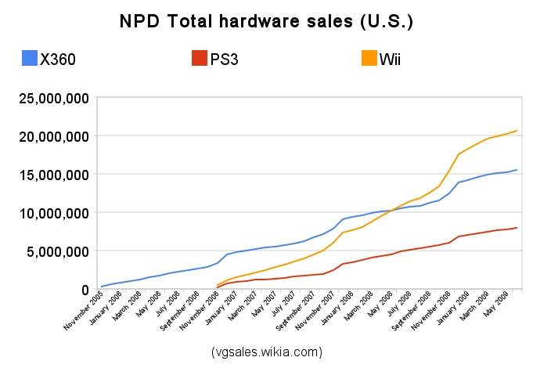

Slide 27
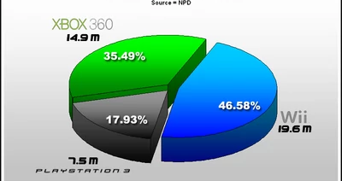

Slide 28

Xbox Kinect
In 2010, to compete with Nintendo’s Wii console and new Nintendo DS, Microsoft released the Xbox Kinect
XBOX Kinect improved the idea of Wii’s IR sensory technology and created a console that was able to incorporate the entire movement of the human body.
Developers for the Kinect gathered data regarding motion-capture of actual moving things in real-life scenarios
Through a machine-learning algorithm, the Kinect can detect movements of people through various backgrounds.

Slide 29
Xbox Kinect depth sensor

Slide 30
Screen Resolutions
People now have a TV that has 1080 or 4K resolution. These resolution sizes allow for smoother gameplay and better graphics
Smart TVs have different screen settings that allow for the user to switch up the visual setting of the TV to fit their specific needs (sports, movies, games, etc.)
Developments for a new 8K resolution TV. There is no 8K TV for sale yet, but many top companies such as LG, Samsung, and Sharp have introduced their prototypes to the public during electronic conventions and other events.

Slide 31
